Slide 1
Operating System
Lecture 19: Protection
Manoj Kumar Jain
M.L. Sukhadia University Udaipur

Slide 2
Module 18: Protection
Goals of Protection
Domain of Protection
Access Matrix
Manoj Kumar Jain Professor Computer Science MLSU Udaipur

Slide 3
Protection
Operating system consists of a collection of objects, hardware or software
Each object has a unique name and can be accessed through a well-defined set of operations.
Protection problem - ensure that each object is accessed correctly and only by those processes that are allowed to do so.
Manoj Kumar Jain Professor Computer Science MLSU Udaipur

Slide 4
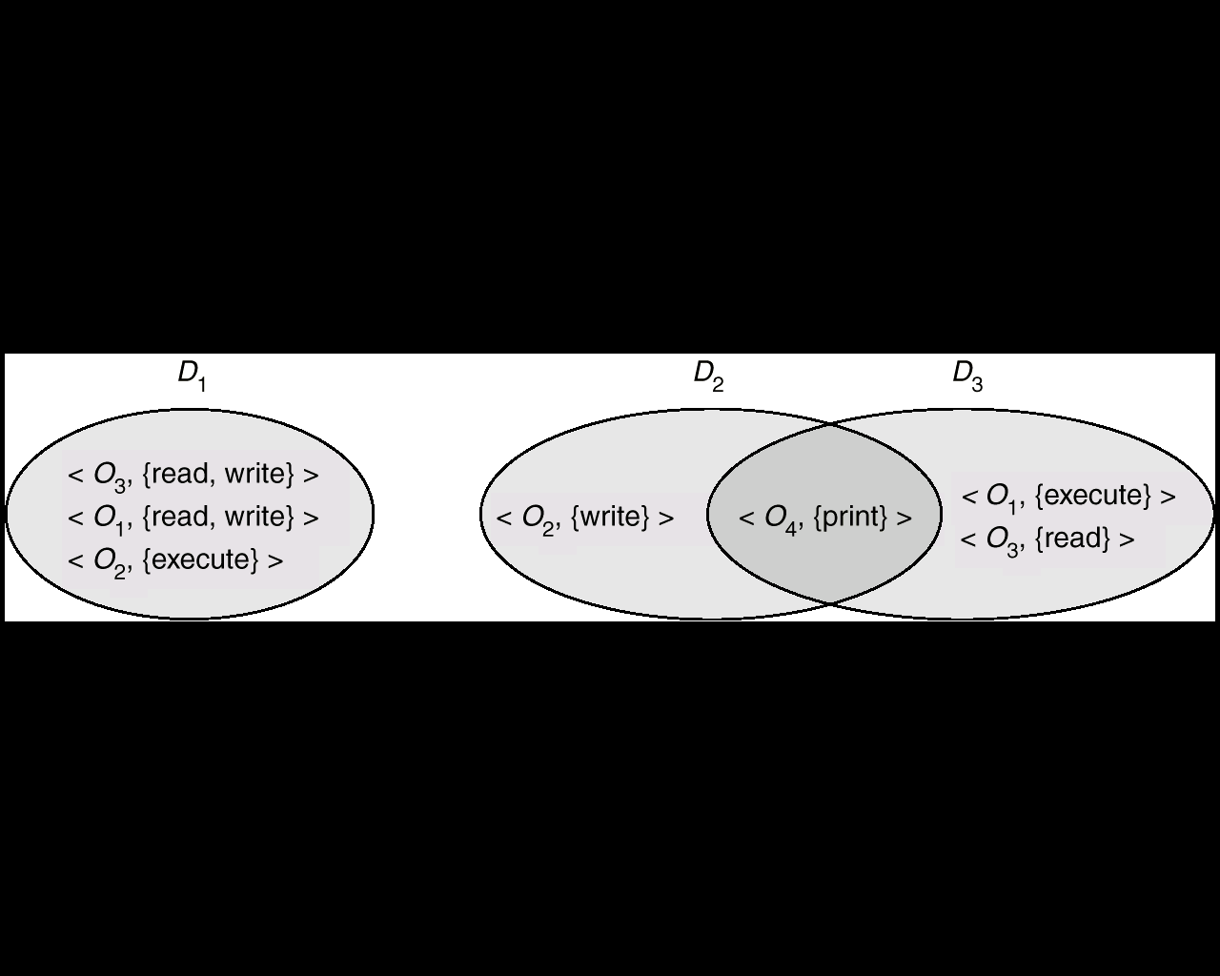
Domain Structure
Access-right = <object-name, rights-set>
where rights-set is a subset of all valid operations that can be performed on the object.
Domain = set of access-rights
Manoj Kumar Jain Professor Computer Science MLSU Udaipur

Slide 5
Domain Implementation (UNIX)
System consists of 2 domains:
  User
  Supervisor
UNIX
  Domain = user-id
  Domain switch accomplished via file system.
    Each file has associated with it a domain bit (setuid bit).
    When file is executed and setuid = on, then user-id is set to owner of the file being executed. When execution completes user-id is reset.
Manoj Kumar Jain Professor Computer Science MLSU Udaipur

Slide 6
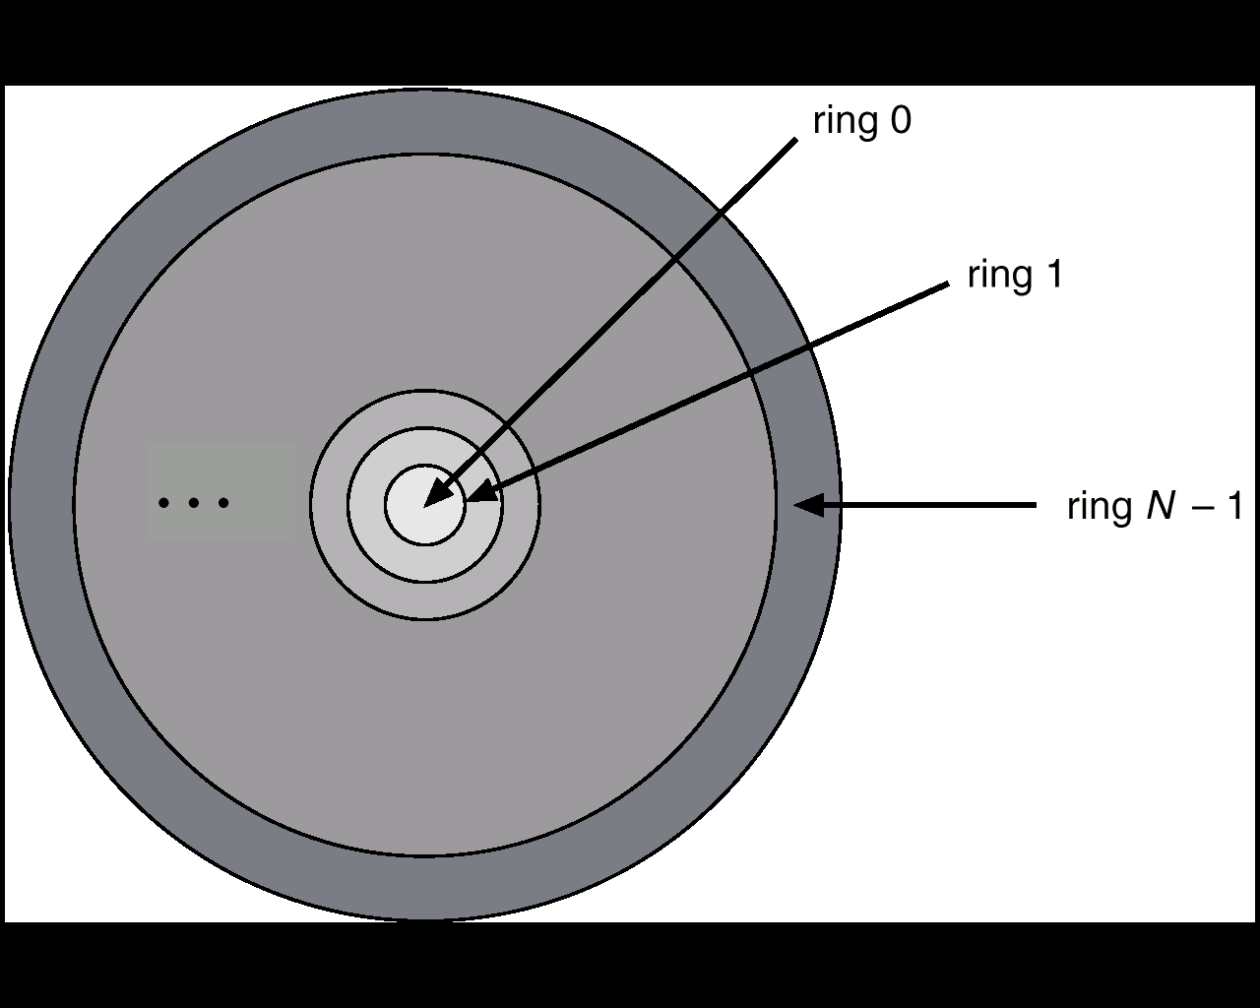
Domain Implementation (Multics)
Let D_{i} and D_{j} be any two domain rings.
If j < I ⇒ D_{i} ⊆ D_{j}
Multics Rings
Manoj Kumar Jain Professor Computer Science MLSU Udaipur

Slide 7
Access Matrix
View protection as a matrix (access matrix)
Rows represent domains
Columns represent objects
Access(i, j) is the set of operations that a process executing in Domain_{i} can invoke on Object_{j}
Manoj Kumar Jain Professor Computer Science MLSU Udaipur

Slide 8
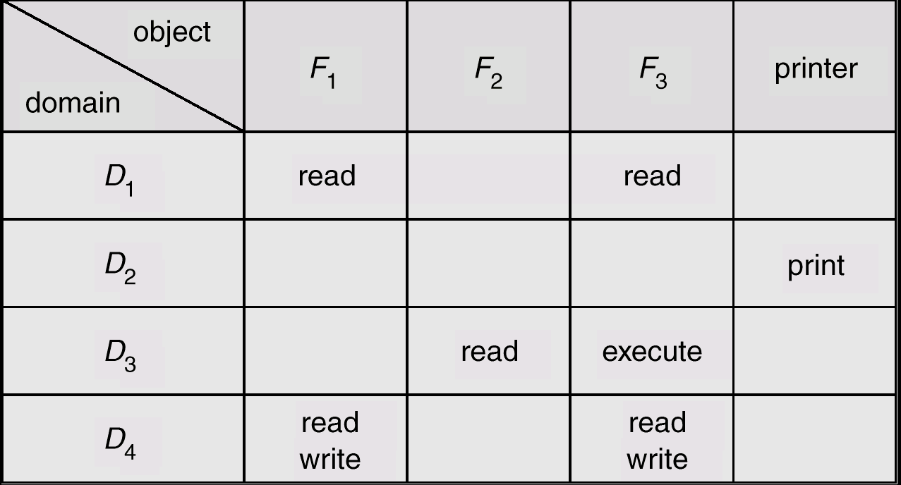
Access Matrix
Figure A
Manoj Kumar Jain Professor Computer Science MLSU Udaipur

Slide 9
Use of Access Matrix
If a process in Domain D_{i} tries to do “op” on object O_{j}, then “op” must be in the access matrix.
Can be expanded to dynamic protection.
  Operations to add, delete access rights.
  Special access rights:
    owner of O_{i}
    copy op from O_{i} to O_{j}
    control – D_{i} can modify D_{j} access rights
    transfer – switch from domain D_{i} to D_{j}
Manoj Kumar Jain Professor Computer Science MLSU Udaipur

Slide 10
Use of Access Matrix (Cont.)
Access matrix design separates mechanism from policy.
  Mechanism
    Operating system provides access-matrix + rules.
    If ensures that the matrix is only manipulated by authorized agents and that rules are strictly enforced.
  Policy
    User dictates policy.
    Who can access what object and in what mode.
Manoj Kumar Jain Professor Computer Science MLSU Udaipur

Slide 11
Implementation of Access Matrix
Each column = Access-control list for one object
Defines who can perform what operation.
Domain 1 = Read, Write
Domain 2 = Read
Domain 3 = Read

Each Row = Capability List (like a key)
Fore each domain, what operations allowed on what objects.
      Object 1 – Read
      Object 4 – Read, Write, Execute
      Object 5 – Read, Write, Delete, Copy
Manoj Kumar Jain Professor Computer Science MLSU Udaipur

Slide 12
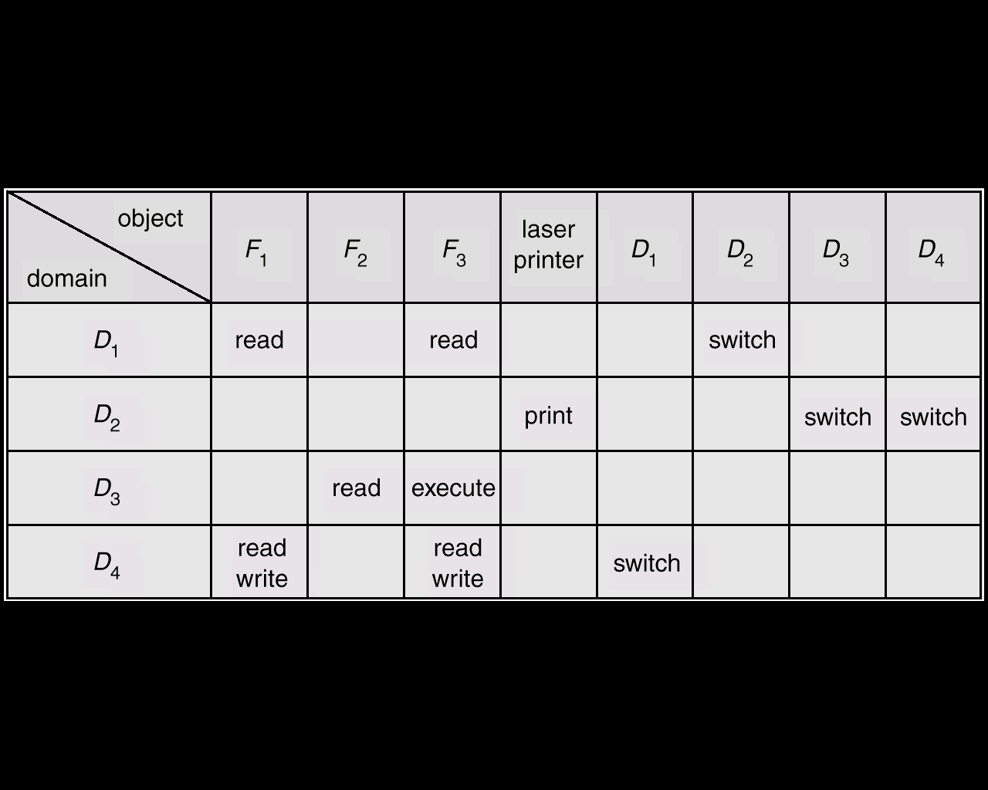
Access Matrix of Figure A With Domains as Objects
Figure B
Manoj Kumar Jain Professor Computer Science MLSU Udaipur

Slide 13
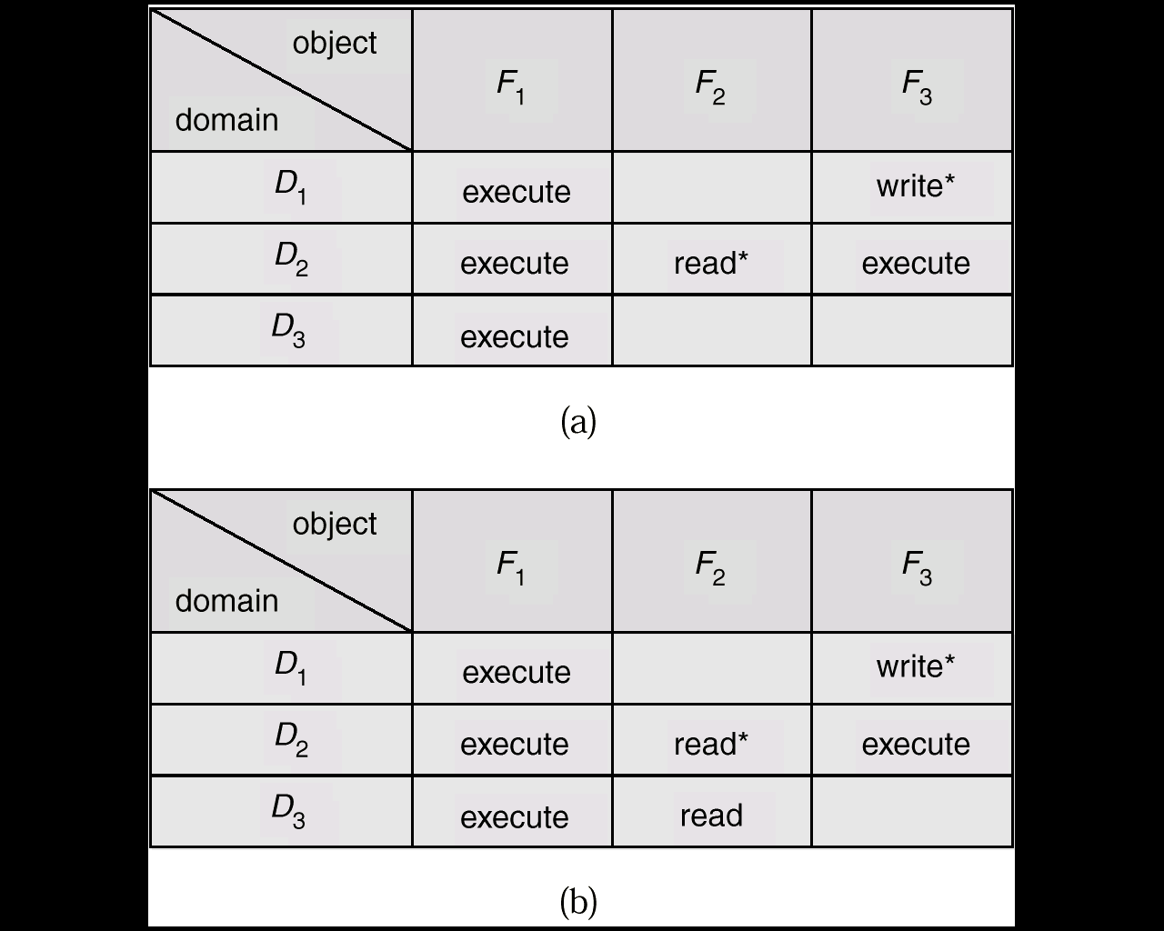
Access Matrix with Copy Rights
Manoj Kumar Jain Professor Computer Science MLSU Udaipur

Slide 14
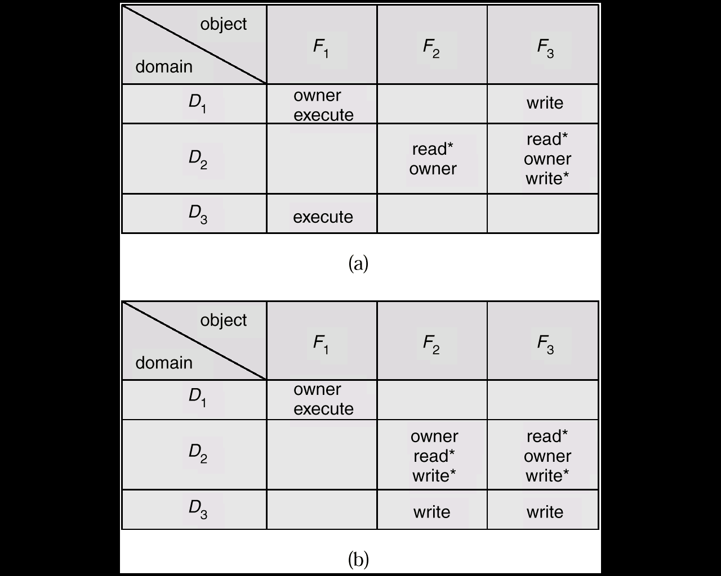
Access Matrix With Owner Rights
Manoj Kumar Jain Professor Computer Science MLSU Udaipur

Slide 15
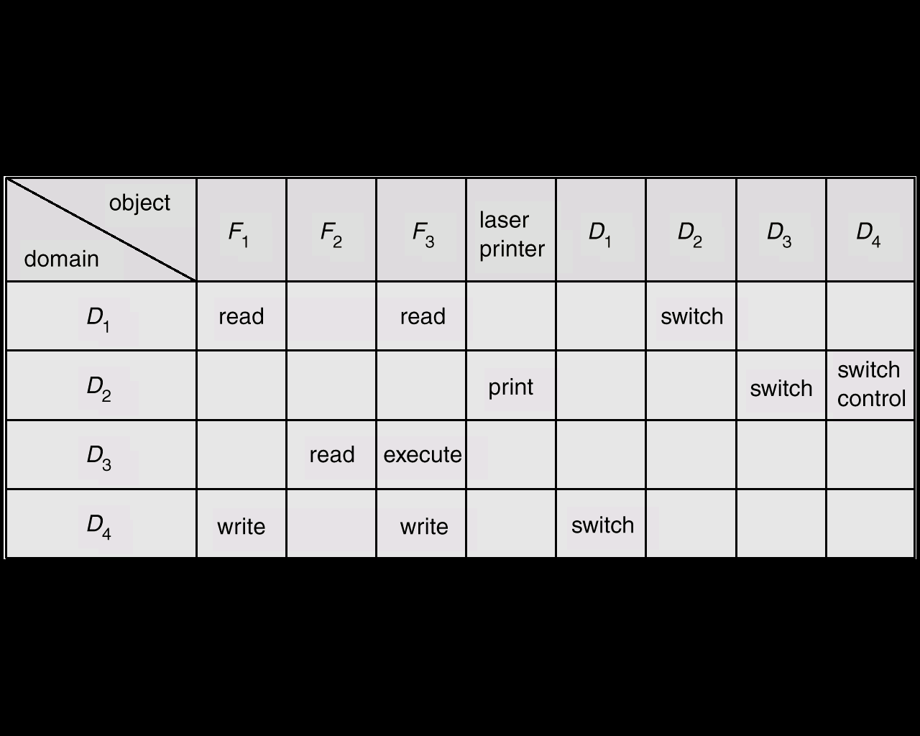
Modified Access Matrix of Figure B
Manoj Kumar Jain Professor Computer Science MLSU Udaipur

Slide 16
Thanks
Manoj Kumar Jain Professor Computer Science MLSU Udaipur

